Slide 1
Automation and Optimization of Hostel Mess Presented By SURYANARAYANA KRISHNAN

Slide 2
INDEX
Introduction
Literature review
Existing Work
Proposed Methodology
References

Slide 3
INTRODUCTION
Preparing food for more than 600 people have its own challenges such as arranging raw materials, estimating food quantity, preparing food according to the student needs and also identifying the rush hours so as to keep up with the needs.
Due to unpredictability of the number of students that eat mess food during different times of the day over the course of a semester for a certain menu, a lot of uncertainty is there regarding the preparation of food.

Slide 4
Why is it needed? :Sometimes excess food prepared goes to waste or there is a shortage due to sudden increase in the number of students. Although some uncertainty will always be there but with proper data collection it can be reduced.

Slide 5
Literature review:
J. W. S. D'Souza, S. Jothi and A. Chandrasekar, "Automated Attendance Marking and Management System by Facial Recognition Using Histogram," 2019 5th International Conference on Advanced Computing & Communication Systems (ICACCS), 2019, pp. 66-69, doi: 10.1109/ICACCS.2019.8728399.
M. Kassim, H. Mazlan, N. Zaini and M. K. Salleh, "Web-based student attendance system using RFID technology," 2012 IEEE Control and System Graduate Research Colloquium, 2012, pp. 213-218, doi: 10.1109/ICSGRC.2012.6287164.

Slide 6
M. Othman, S. N. Ismail and H. Noradzan, "An adaptation of the web-based system architecture in the development of the online attendance system," 2012 IEEE Conference on Open Systems, 2012, pp. 1-6, doi: 10.1109/ICOS.2012.6417619..
Rjeib, Hasanein & Ali, Nabeel & Al Farawn, Ali & Al-Sadawi, Basheer & Alsharqi, Haider. (2018). Attendance and Information System Using RFID and Web-Based Application for Academic Sector. International Journal of Advanced Computer Science and Applications. 9. 266-274. 10.14569/IJACSA.2018.090137.

Slide 7
Existing Work
1) RFID Model:
Refers to an attendance system but using Radio Frequency Identification (RFID) technology
This system includes essential online capabilities for convenient record keeping, which are available not only to lecturers but also to relevant academic administration staffs for the purpose of monitoring students' development.

Slide 8
FR Model
Describes an attendance system which uses facial recognition to automate the process of taking and marking attendance.
Face recognition is accomplished using image processing techniques in this study.
The processed picture is compared to the current stored record, and attendance is recorded accordingly in the database.

Slide 9
Canteen Management System
It enables the canteen manager to generate the daily food planning report after ensuring that all records have been downloaded and the time has expired.
The usage of this Canteen Management Software allows the user to track each employee's food consumption over time, preventing food waste and accounting problems along with paperless transaction feature.

Slide 10
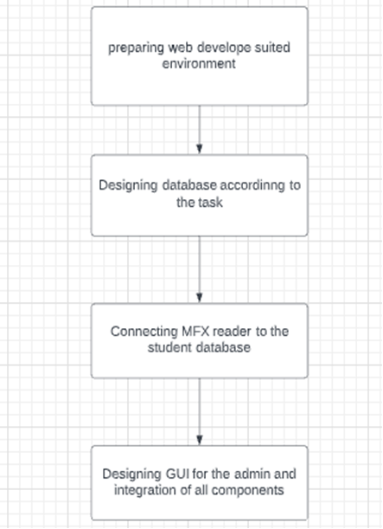
Proposed Methodology

Slide 11
1)HARDWARE
1.1)MFX READER
Through the user's cell phone, this truly contactless reader validates safe identity (Android or iOS).
1.2) STUDENT ID CARD
Student of id cards of Bits Pilani use MIFARE technology for various purposes such as log in/out of library, smart printer etc. ID cards can also store money for using the smart printer and other campus expenses.

Slide 12
2) SOFTWARE
2.1) WEB SERVER
The word "web server" refers to technology (application) that aids in the distribution of publicly accessible content via the Internet. It facilitates web site functioning by accepting requests from the user's browser and replying with HTML documents (Web pages) and files.
The data collector module, a database, and the graphical user interface (GUI) pages that enable online interactions with system users to enable the system's dynamic capabilities using CSS and JAVASCRIPT compose the web server.
.

Slide 13
SYSTEM IMPLEMENTATION
1) MFX Reader
Our proposed system involves a MFX reader which can be installed near the plate racks so that students can record their presence while taking plates. These readers are connected to a hub by means of a LAN port as it needs internet access to connect with the data reporter.

Slide 14
2) Web Development
The web application will be developed in accordance with XAMPP server. This allows hosting web server on the local host and allows scripting using PHP. A database is also hosted along with the server by means of XAMPP.

Slide 15
3) MySQL Database
This web-based system is connected to a database. The database mainly consists of 4 columns namely roll no., breakfast, lunch and dinner for each day. These data are first collected from the MFX reader by the Data Reporter element, and then sent to the Data Collector, which is in charge of saving the information in the database.
This valuable data combined with traffic statistics can be efficiently be used for determining an ideal menu.

Slide 16
4) Graphical user interface (GUI)
GUI needs to be designed keeping in mind the user i.e., the hostel mess staff and also students who want to access the webpage for submitting feedback form.
A navigation bar will be provided to segregate these needs along with a separate view for displaying the latest mess menu. Bootstrap is a good collection to use for implementing the above-mentioned GUI components.

Slide 17
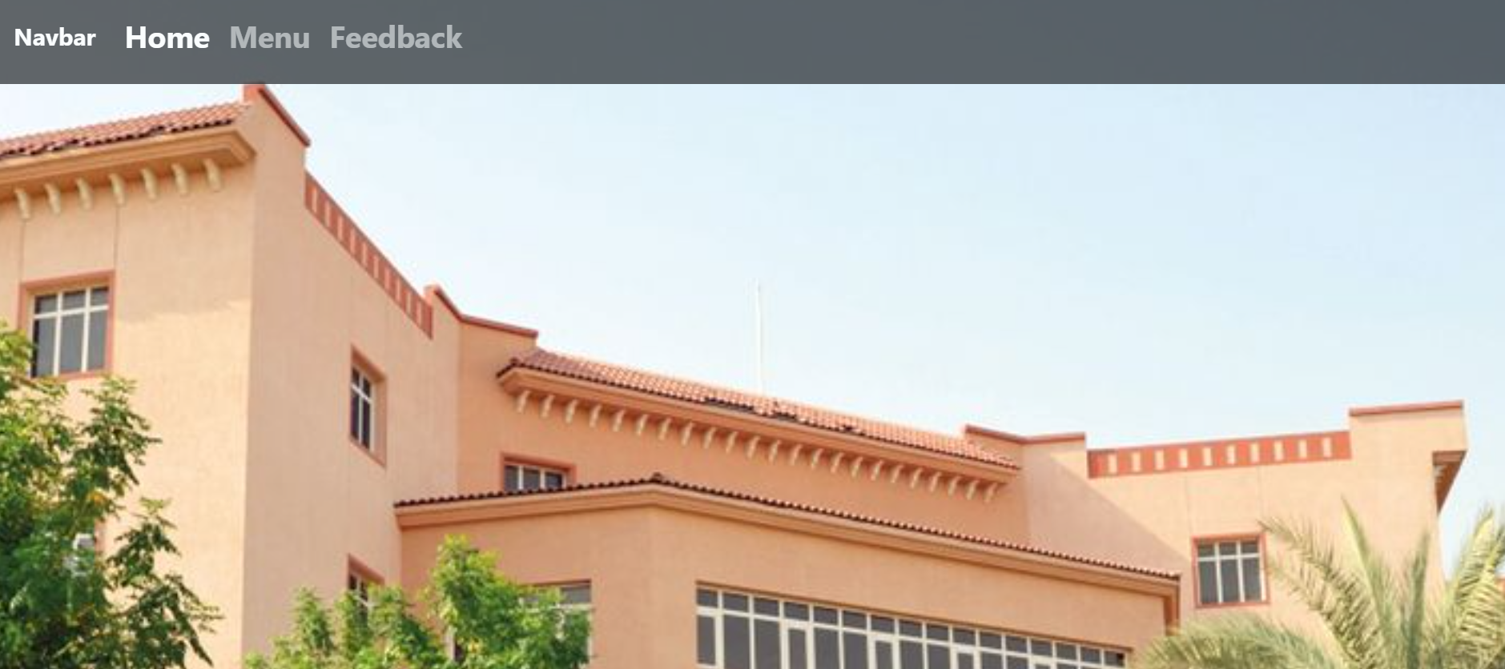
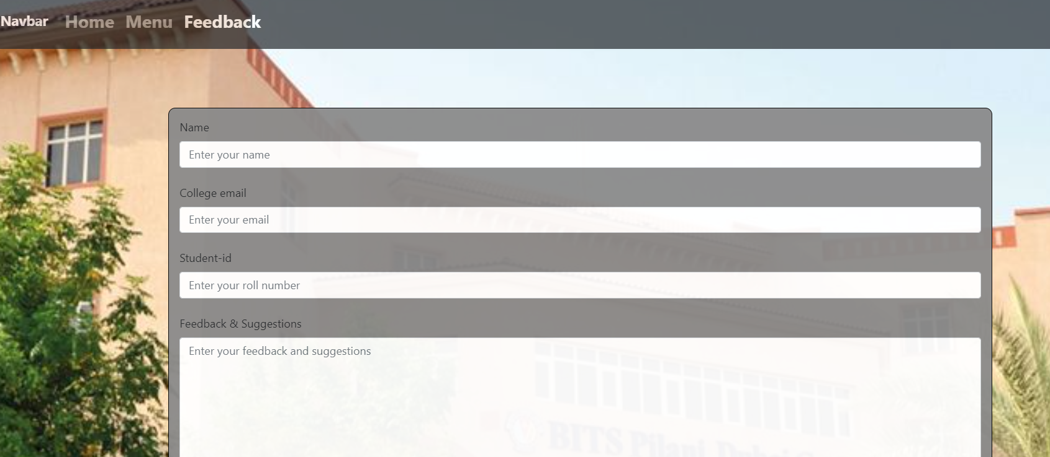
Implementation Progress

Slide 18
1] https://ieeexplore.ieee.org/abstract/document/8728399
2] https://ieeexplore.ieee.org/abstract/document/6287164
3] https://ieeexplore.ieee.org/abstract/document/6417619
4] https://www.researchgate.net/profile/Nabeel-Ali-10/publication/322862382_Attendance_and_Information_System_Using_RFID_and_Web-Based_Application_for_Academic_Sector/links/5a733cf7aca2720bc0dbb3aa/Attendance-and-Information-System-Using-RFID-and-Web-Based-Application-for-Academic-Sector.pdf
5] https://en.wikipedia.org/wiki/MIFARE
6] https://www.ysoft.com/en/mfxmobile
REFERENCES

Slide 19
Thank you

